Slide 1
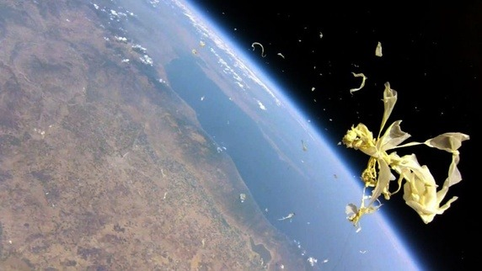


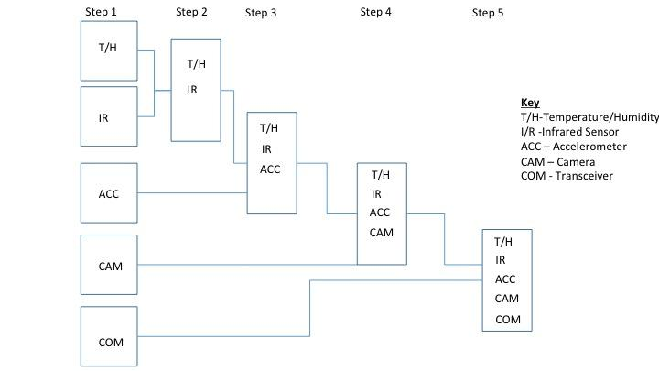
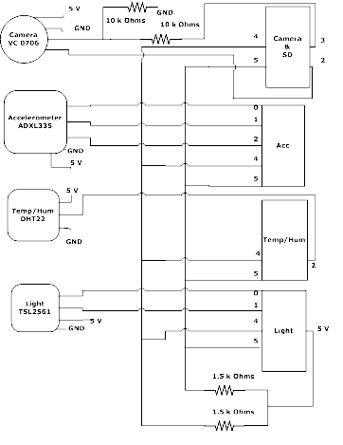
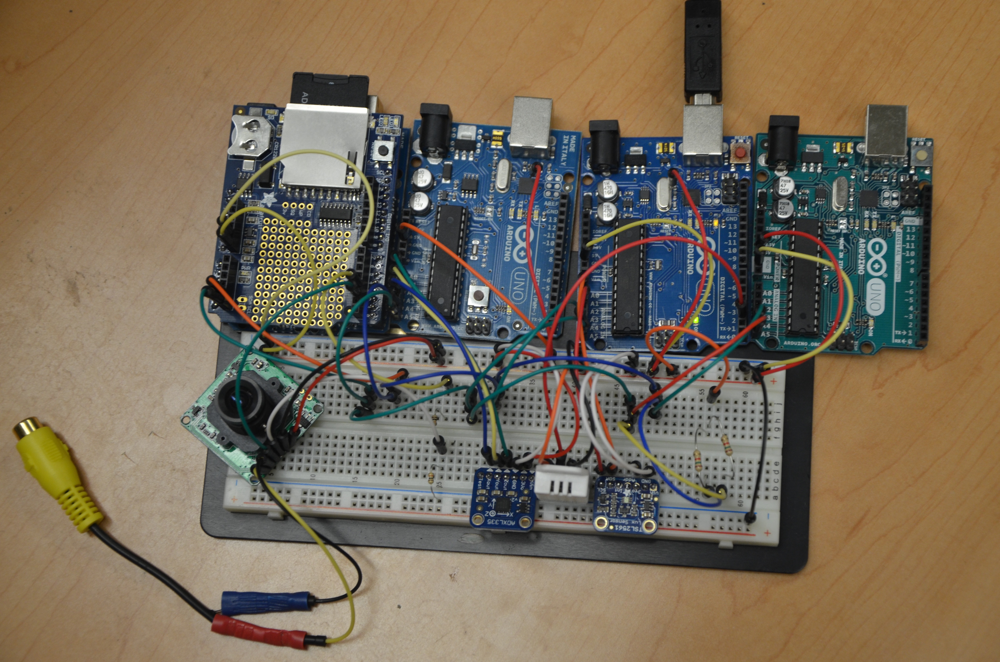
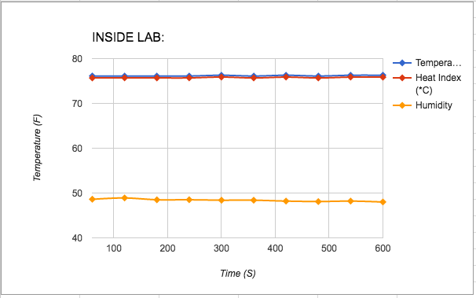
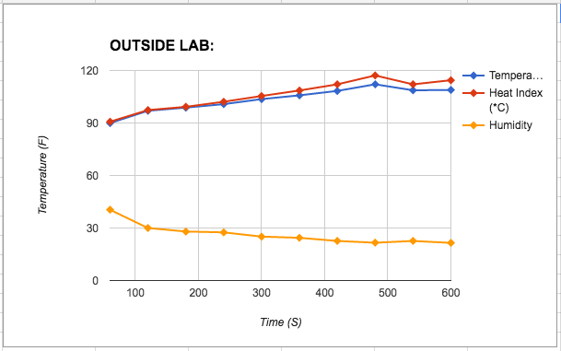
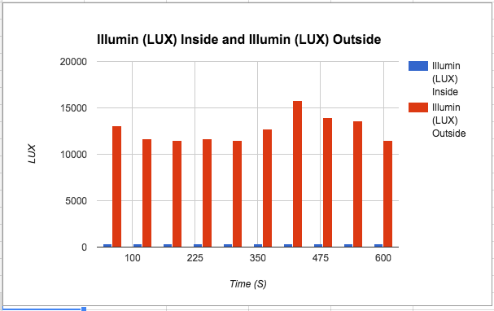
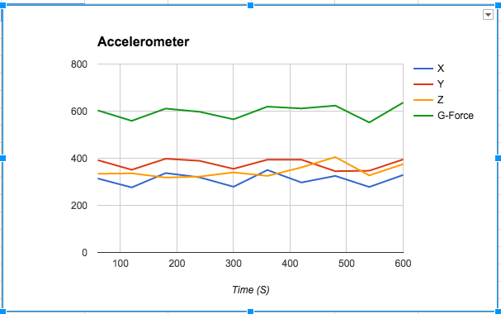
Intelligent Software Control for Nanosatellites
Interns: Jason Craigg, Ahmed Diallo, Robert Lucci, Matt Walls
Faculty Mentors: Dr. Shermane Austin, Prof. Michael Jiang
Software for controlling, tracking, and communicating with satellites is developed following best practices and must be robust with the ability to tolerate and recover from the unexpected. Despite following best practices, when the software is used in critical missions, it may be very risky to assume that the software is free of faults. Further, if the system is to be used in a dynamic and complex environment, it might face unexpected situations not considered during its design. Autonomic Computing (AC), a vision and architecture proposed by IBM, relies on the use of AI techniques to build computing systems with self-managing characteristics so that they are able to adapt to unpredictable changes while hiding intrinsic complexity to operators and users. An AC system makes decisions without assistance, using high-level policies. The system has sensors for self-monitoring, effectors for self-adjustment, and knowledge and planner adapter for exploiting policies based on self- and environment awareness.
This project involves the implementation and testing of AC-based framework and software for a CubeSat with a radio-occultation mission. Preliminary steps involve design and assembly of an Atmega-386 model with a camera, temperature-humidity sensors, 3-axis accelerometer, infrared sensor, data logging shield with a micro-SD card, and defining AC-based policies for the components based on power management and risk mitigation. After completion of the software, the system will be tested on a sub-orbital platform.
Arduino is a device that allows one to create electronic gadgets with very limited budget and engineering knowledge: it incorporates simplified circuits and code which makes it easy to make use of attachments such as sensors. Several sensors are used, including: TSL2561 Luminosity Sensor which measures illuminance in a wide range of light situations; ADXL355 Triple Axis Accelerometer which measures acceleration on 3 (x, y and z) axes; DHT22 Temperature-Humidity sensor which measures temperature and humidity; VC0706 TTL serial JPEG camera which is used to take pictures. In addition to this, a data-shield acts as a physical add-on to the Arduino, allowing the use of an SD card without using any pins.
Our team objective is to draft, create and eventual trial of a CubeSat taking steps to implement necessary traits such as power budgets, weight restraints, communications and data handling, amongst others. Largely integrated is Autonomic Computing (AC): which refers to the traits of a computer system that governs its ability to self-manage, such as adapting to erratic changes and overcoming hindrances while remaining opaque about its complexity toward users.
ABSTRACT
METHODS
CONCLUSION
Integration Procedure
Simple BalloonSat
Prototype Schematic
We started our CubeSat by assigning a sensor for each student. By specializing in our individual sensor, our next step was to integrate our sensors into a fully functional CubeSat. Initially, the camera was a challenge to get operating. Progress was made and we accomplished the feat. However, once we tried to interface the camera with the sensors, we ran into low memory constraint. Our two prospective approaches were to try to simplify header file code or interface multiple Arduinos together, to essentially create a microcontroller network. The latter was the one we chose. However, we are still in the process of further attempting to get this project to work because the light sensor needs the same pins (analog 4 & 5) as the I2C bus to function. We concluded that we can use delays to resolve data conflicts. Furthermore, as we venture into the process of accomplishing this, we also have to work with power management and incorporating the use of autonomic computing into our CubeSat.
[1]www.adafruit.com
[2]www.arduino.cc
[3]http://www.nasa.gov/sites/default/files/files/ELaNa-IIFactsheet508(1).pdf
[4]http://www1.cuny.edu/mu/forum/2013/11/14/medgar-evers-college-set-to-launch-satellite-on-nasa-rocket/
[5]www.smartdraw.com
[6]http://digitalcommons.usu.edu/cgi/viewcontent.cgi?article=2070&context=etd
[7] Landa, P., McCann, J. A., Diaconescu, A., (2014). Autonomic Computing Principles, Design and Implementation.
[8]London: Springer Wertz, J. R., Everett, D. F., Puschell, J. J. (Eds.). (2011). Space Mission Engineering: The New SMAD (Space Technology Library, Vol. 28).
Hawthorne, CA: Microcosm Press
NASA, New York City Research Initiative, New York NASA Space Grant Consortium, Goddard Institute of Space Studies, and GSFC Office of Education contributed greatly to this research project.
The testbed system includes four Atmega 328 microcontrollers communicating via a system bus, thermal monitoring with temperature/humidity sensors, a low-profile IR sensor, a low-resolution camera, an accelerometer, internal storage, GPS receiver, and transceiver. Defined system requirements will also include the integration of a reaction wheel at later stages. Preliminary integration and testing of the component suite has been underway to provide guidance for power, data and link budgets and telemetry needs as an initial basis for system and resource requirements.
RESULTS
This investigation is still in preliminary stages. Only a partial integration and testing of the testbed system has been completed. Identification of risks, potential faults and required transformations and budget determinations have not yet been completed and microcontroller trades are needed.
Introduction/Background
REFERENCES
Figure 1: This figure details the temperature and humidity inside the lab.
Figure 2: This figure details the temperature and humidity outside the building. We can observe a change of temperature as we move from the building to the outside of the parking lot.
ACKNOWLEDGEMENT
Figure 3: This figure represents the lux calculated inside and outside of a building. There is an unexpected sinusoidal trend that we believe may represent this particular light source outside the building, dimming and brightening at pseudo-regular rates.
Figure 4: The ADC on the Arduino converts voltages to a value between 0 and 1023. These are then converted to g’s (which is a force caused by acceleration similar to gravity factor) using a formula and knowledge of the unit obtained from the datasheet. This accelerometer is 3-axis which detects x, y, and z accelerations.

